Slide 1
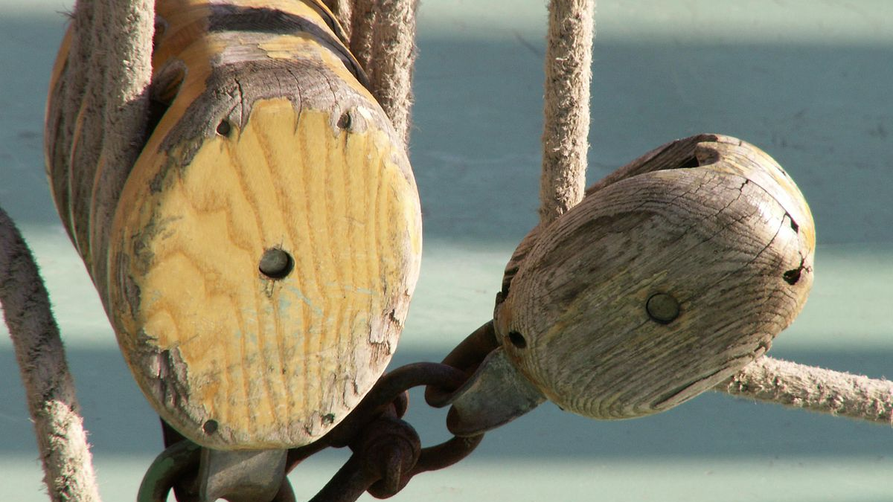
Simple Machines
By Colin Kinzie
This Photo by Unknown author is licensed under CC BY-SA.

Slide 2
Pulley
Notes:
A pulley helps raises and lower heavy objects. Some example of a pulley are a flag, a sail, a fishing net and a crane.

Slide 3
Inclined Plane
This Photo by Unknown author is licensed under CC BY-NC-ND.
Notes:
A inclined plane is a slanted surface that if you are going down, you need to apply less force. But if you are going up you need more force. Some examples of a inclined plane are steps, hill, ladder and a parking garage.

Slide 4
Screw
Notes:
A screw is a inclined plane that makes it easier to work with. Some examples of a screw are drill bit, a bottle opener for wine, a stool and screws.

Slide 5
Lever
Notes:
A lever helps lift loads and move loads. Some examples of a lever are seesaw, fork, stapler, rake, toilet handle, knife, scissors and a bat.

Slide 6
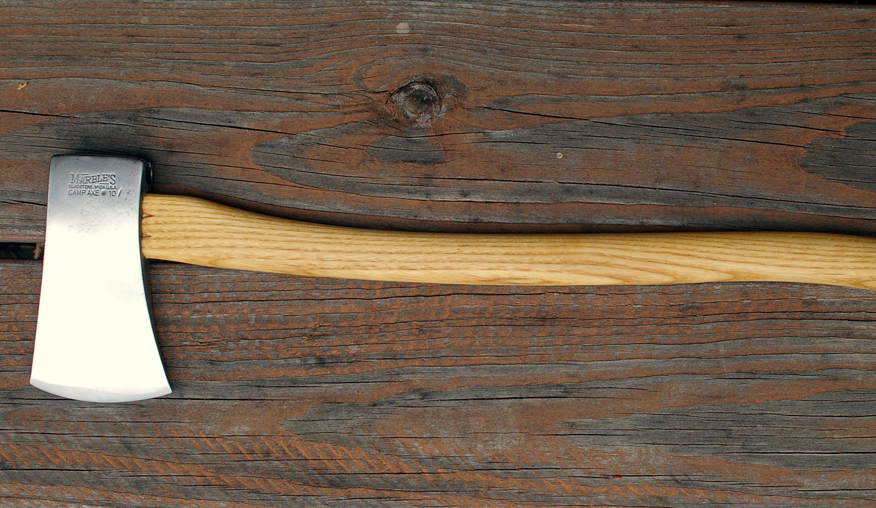
Wedge
Notes:
A wedge is used to apply force to a object or split it. Some examples of a wedge are an ax, chisels, pins, back wedge, knitting needles and a car wedge.

Slide 7
Wheel & Axle
Notes:
The wheel & axle are a wheel on a rod called a axle. Some examples of a wheel & axle are a fan, a pinwheel, tires, rolling pin, old fashion phone, wagon and a pencil sharpener.

